Slide 1
Sealingtech Lunch and Learn: Pt.1 – Docker
Markus Mabson
Daniel Lohin

Slide 2
Agenda:
Introduction to Docker and Kubernetes
Docker Overview
Docker lab
Kubernetes Overview
Kubernetes Lab
Intro to Calico and Kubernetes networking (time permitting)

Slide 3
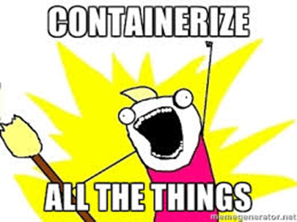
Introduction to Docker and Kubernetes
Rapid Deployment, Isolated Environment, Developer productivity.

Slide 4
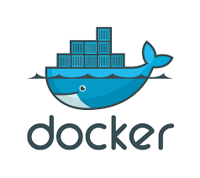
What is Docker?
Docker, is an open-source project that automates the deployments of applications inside of user created containers by providing an added layer of abstraction and automation that has the capability to perform operating system level virtualization.

Slide 5
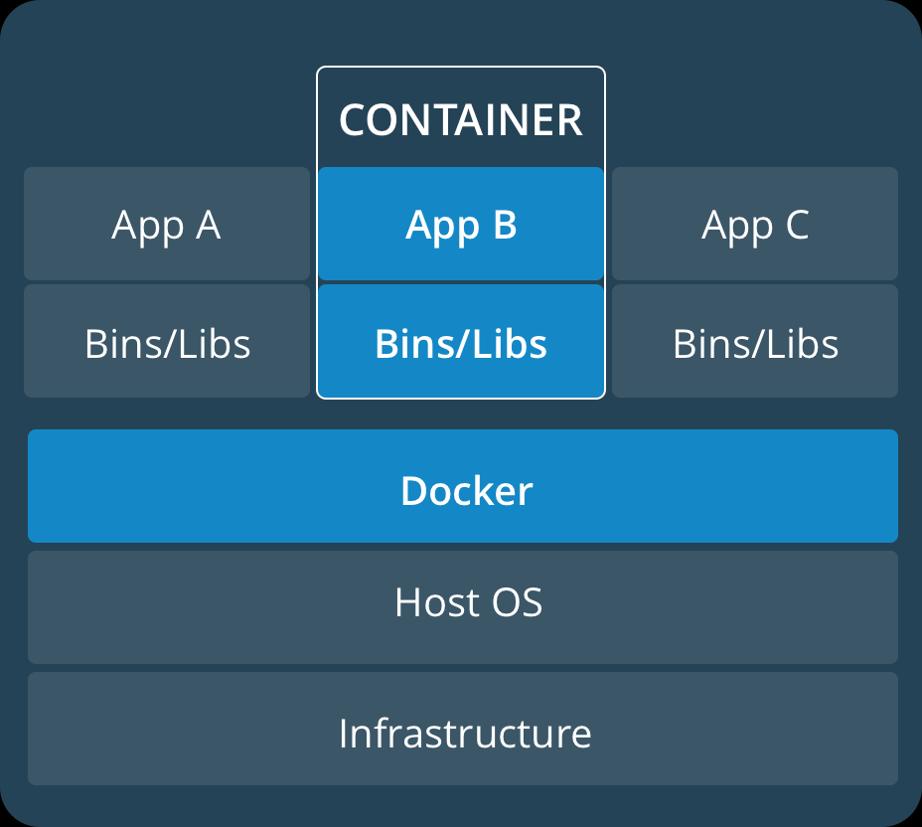
A Container?
Lightweight, stand-alone software that includes system tools, system libraries executable package.
Packaged software for development, shipment as well as deployment
Containers share the machine’s OS kernel
Containers are isolated using namespaces
PID
Networking
Mount Points
UID/GID
Limit processors and memory
And more!

Slide 6
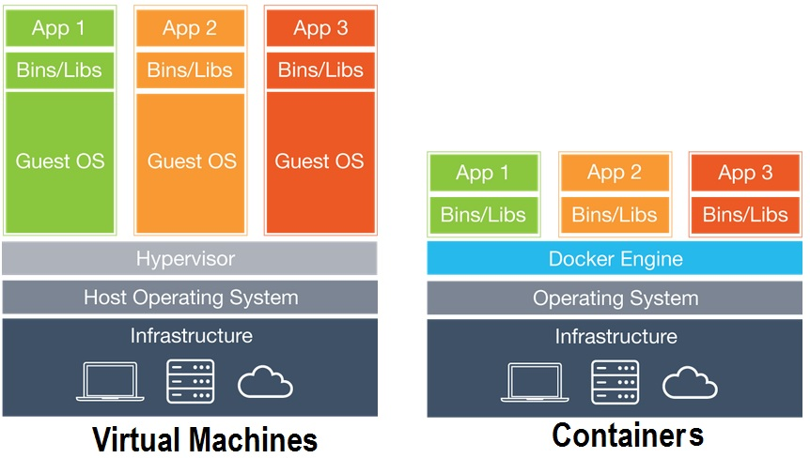
What’s the Difference?

Slide 7
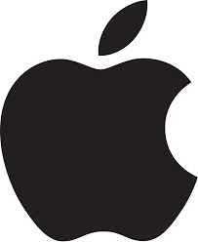



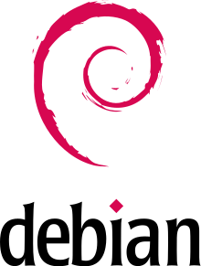

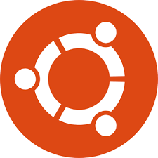
Supported Platforms

Slide 8
Kubernetes
A method of orchestrating containers across cloud type environments
Developed by Google based on how they internally managed their infrastructure
Focuses on building highly scalable systems using commodity hardware
Orchestrates the networking, storage and compute using ”infrastructure as code” design

Slide 9
What is Kubernetes
Kubernetes acts as an abstraction to the infrastructure so that applications don’t need to understand the details of what it looks like
Kubernetes is highly extensible with plugins and every cluster will look different, but generally that is ok because Kubernetes solves the details for you. As long the the plugins and clusters follow a certain set of rules, the underlying details not longer matter.
Kubernetes is designed to deploy and manage the lifecycle of containers across a number of hosts

Slide 10
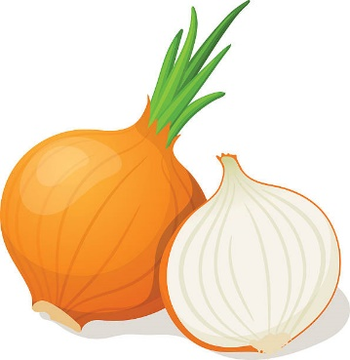
Dockerfile
A Dockerfile, is a text document that holds all the commands that a user could call on the command line to create an image.
Images generally just contain a single application and all the libraries that are needed to run that application
Like onions and Ogres, images have layers this consumes less space and allows for faster deployments
A lot of dockerfiles already exist for your common applications on Docker Hub!
Generally you will start with an image, extend the image with your customizations and create a new image.

Slide 11
What does this solve?
Configuration management – Think of how many times in your IT career you decided that it was best to start over with a server?
Upgrade path craziness and testing – oh you went from 1.11 to 1.13, we didn’t test that why didn’t you install 1.12
Documentation hell – mounds of documentation that can be unclear, as well as operator error
Makes development, testing and production a highly repeatable operation – how many times did you find a bug in production because they were using some other piece of hardware or software that wasn’t in testing.

Slide 12
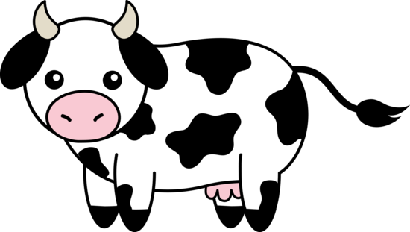

Cattle vs Pets
Phrase used a lot in the Kubernetes and Container communities
Pets are servers, Containers are cattle
Pets we care for, we feed, we take them to the doctors when they are sick
Cattle we use them, and when they are no longer of use we shoot them
THIS IS HOW YOU NEED TO START THINKING!

Slide 13
Some core concepts of Devops
Docker and Kubernetes exist as technologies to enable Devops. Here are some key concepts:
Containers are cattle, not pets. Use them, shoot them and then move on
Fail fast – we will fail, but it is important that when we fail we can quickly revert back to a known state.
Continuous Integration - Deploy small changes more frequently
Shared environments – Dev, test, production should all be identical if not the same
Deployment should be as hands off as possible.

Slide 14
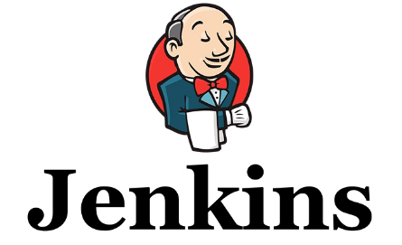
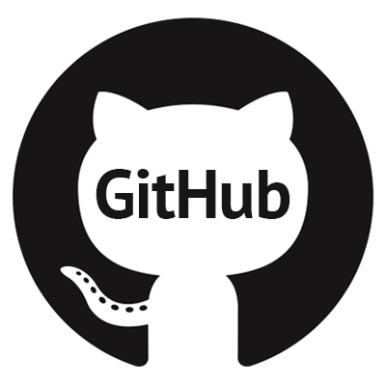
Devops process with Kubernetes
Dev
Test
Prod
Build applications (if necessary)
Build Docker containers and push to repository
Build Kubernetes Yaml files
Deploy to development area of cluster
Automated testing
Preliminary testing
Deploy Kubernetes YAMLs into test area of cluster
Test product
Deploy Kubernetes YAMLs into production area of cluster
Automated build and testing
Version management and CM

Slide 15
Who?
Everyone!
Work is front loaded as much on dev as possible
By the time it makes it to operations, deployment should simply be pressing a button
Operations can now focus on maintaining and monitoring the cluster and less time on deploying applications and figuring out how to make them work

Slide 16
Docker Overview

Slide 17
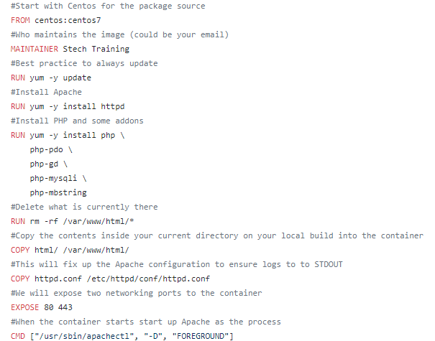
Nginx – Dockerifle
From centos:centos7 – This line will be the image to start from, this comes with some very basic tools like yum and most importantly you can no use Centos repositories for all your applications and libraries
Maintainer – who maintains the image (generally an email)
RUN commands- run these commands in order to build the image
COPY – we can copy files and directories from our current working directory into the directory structure of the container
EXPOSE – mostly used to document what ports will be used
CMD – This is the command that will be run when the container comes online

Slide 18
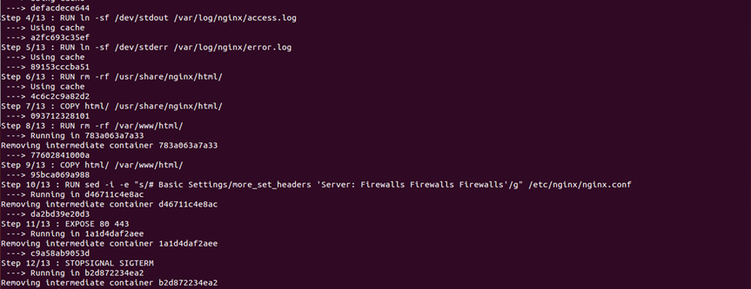
Container Creation
$ Docker Build –t nginx .

Slide 19
Resources
Github - https://github.com/docker
Docker Hub – https://hub.docker.com/
Docker - https://www.docker.com/

Slide 20
Try it yourself!
*Link to completed Docker Guide –[Sharepoint]*

